Slide 1

BOC 1012 High Performance Heating & Cooling Equipment and Energy Savings through Energy Recovery Edition 2.0
APPENDIX
OF
SUPPLEMENTAL READING
Notes:
BOC 1012 High Performance Heating & Cooling Equipment and Energy Savings through Energy Recovery
Edition 2.0
Appendix of Supplemental Reading

Slide 2
Appendix
Heat Recovery: Supplemental Reading B-1

Slide 3
Energy Recovery Systems
Supplemental Reading

Slide 4
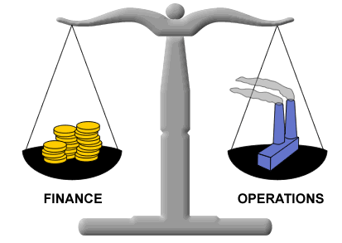
Financial Considerations
Installing energy recovery equipment makes financial sense when it proves to be cost effective.
Savings
Total costs
Photo: jaipals.com
Notes:
Although there is benefit from saving energy regardless of cost, it makes financial sense to install energy recovery equipment only when it proves to be cost effective. Energy savings from the equipment will have to be weighed against all of the costs associated with its use.
Recovering and using energy that has already been used by your building can be considered “free” energy. However, this process typically incurs some cost, and there are many factors that have to be considered when determining what the total costs are. Performing a life cycle cost analysis considers all of the benefits and costs associated with the equipment and is useful when evaluating the cost effectiveness of an energy recovery system.

Slide 5
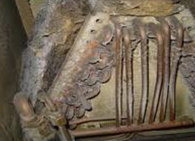
Financial Considerations
Cost effectiveness factors—expected efficiency vs. actual:
Published energy recovery efficiency data is considered “best case.”
Published efficiencies can be expected when equipment is properly maintained and clean.
Periodic functional testing of equipment should be performed to verify operation.
Photo: mikesandsappiosheatingandair.com
Notes:
Manufacturers publish data about the effectiveness of their energy recovery equipment. Published data suggests these values can range from 50% to 85%, depending on what type of energy recovery it is.

Slide 6
Financial Considerations
Cost effectiveness factors
Total cost of energy recovery
First cost of equipment, labor & controls
Ongoing operations & maintenance costs
Added energy costs
Notes:
The most obvious costs of installing energy recovery equipment include what you would have to pay a contractor to install it. This would include all of the necessary equipment, as well as their labor charges. In addition to these costs, there are others:
Costs to add controls to the equipment and tie into the building automation system
Costs of maintaining the equipment on a regular basis to ensure proper and efficient operation
Added energy costs from auxiliary equipment. Can include pump energy for runaround loop systems, and increased fan energy from additional pressure drop across heat exchanger(s).

Slide 7
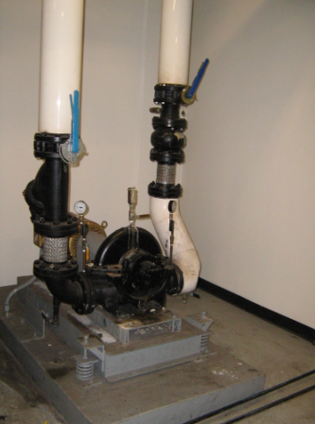

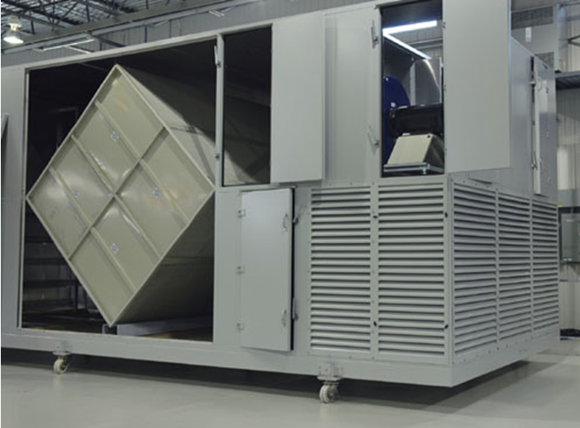
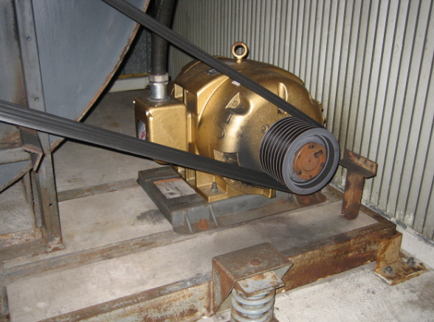
Financial Considerations
Net efficiency considers energy penalties such as increased pressure drop and pump energy.
Photo: todayifoundout.com
kWh
Photo: PECI
Photo: PECI
Notes:
Energy recovery can include added energy costs and depend on the energy recovery device used. For example, fixed plate energy recovery ventilators (shown) and energy wheels add a pressure drop to the system. This increases fan energy costs and may require an increase in fan motor size.
Runaround loop energy recovery requires the use of additional pumping energy. Although these add cost, the net benefit of recovering energy should outweigh the additional energy used to operate the energy recovery equipment.

Slide 8
Financial Considerations
Now consider the benefits!
Continued reduction in energy use for life of the equipment
Cost savings associated with downsized heating, cooling, humidification and dehumidification equipment
Notes:
The net benefit of using energy recovery should outweigh the costs in order for it to be cost effective.

Slide 9



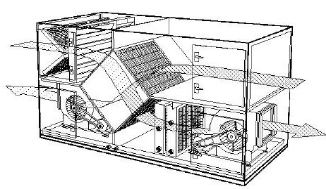
Financial Considerations
Net energy savings from using energy recovery device
Additional energy input
Capital equipment cost
Installation cost
O&M cost
Recovered energy
Smaller HVAC equipment

Slide 10
Financial Considerations
Utility incentives and tax credits
As an added incentive to install energy recovery equipment in your facility, there are cash incentives and tax credits available in many states.
Usually based on $/kWh and/or $/therms saved
When incentives are included in the cost benefit calculation, payback times can be much shorter.
Notes:
Including incentives and tax credits in your cost analysis can result in faster payback of the costs associated with energy recovery. Determine what incentives for energy recovery are available in your area with the use of energy recovery by visiting the website http://www.dsireusa.org/.

Slide 11
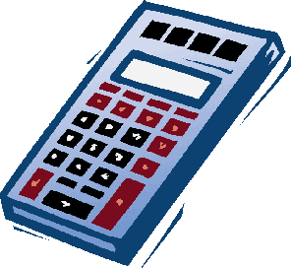
Financial Considerations
Utility incentives and tax credits
Usually require a customized energy saving calculation or energy model to determine the energy saved
Some agencies have a calculator that can quickly be used to calculate energy savings
Photo: www.saveonphone.com
Notes:
In some cases, the incentive for installing energy recovery equipment may be compensation for a portion of the project cost. In other cases, the incentive may be based on the amount of energy saved. Determining how much energy an energy recovery system saves usually has to be done with a custom energy saving calculation or energy model. Some agencies and utilities have a calculator tool that can be used to quickly estimate the energy savings and incentive.

Slide 12
Resources
Energy Design Resources: http://www.energydesignresources.com/
Database of State Incentives for Renewables and Efficiency: http://www.dsireusa.org/
ASHRAE Handbook–HVAC Systems and Equipment: http://www.ashrae.org/

